Slide 1
Lecture 7

Slide 2
Question
In PH121, did you study stress and strain
Yes
What is a stress?
What is a strain?
What is PH121
No

Slide 3
What you need to know
Stress and strain equations for tensile stress and bulk (pressure) stress.
The wave speed is always the square root of an elastic property divided by an inertial property.
The intensity of sound waves is proportional to the amplitude squared.

Slide 4





Equations you actually want
Pressure stress
Tensile Stress
Bulk Modulus
Sound Intensity
$$P=\frac{F}{A}$$
$$\frac{F}{A}=Y\frac{∆L}{L_{o}}$$
$$v=v_{o}\sqrt{1+\frac{T_{c}}{T_{o}}}$$
$$∆P=−B\frac{∆V}{V}$$
$$\left\langle I\right\rangle =−\frac{1}{2vρ}{\left(ΔP_{max}\right)}^{2}$$

Slide 5
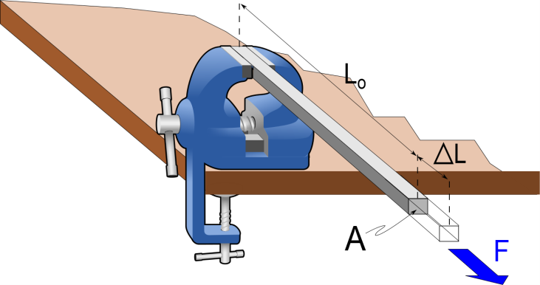
Question 123.7.1
I have two bars made out of different materials. Bar A has a Young’s modulus that is half that of bar B. I apply a force F to each bar. Which bar stretches more?
  Bar A
  Bar B
  They stretch the same

Slide 6
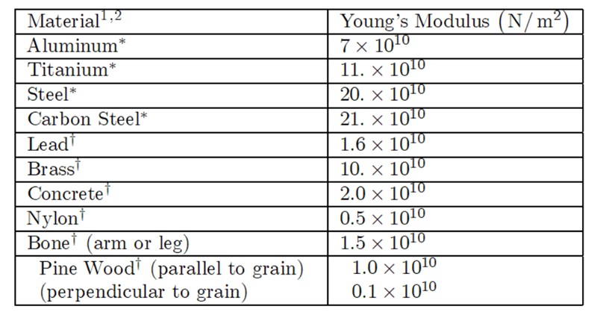

Slide 7


Cross sectional area, A
dx
dm
$$T_{ℓ}$$
$$T_{r}$$

Slide 8
Review Problem
Suppose we have a steel piano wire. One end of the piano wire is fixed in place, and the other is connected to a peg that can be rotated so the piano wire is tightened. This is what you do when you tune a piano, you turn the peg and tighten the wire. Suppose we tighten the wire so that there will be 980N of tension on the wire. The wire is 1.6m long and has a diameter of 2mm. How much will the wire stretch as we tighten the peg? We will need to know that the Young's modulus for steel is 20×10¹⁰N /m³.

Slide 9
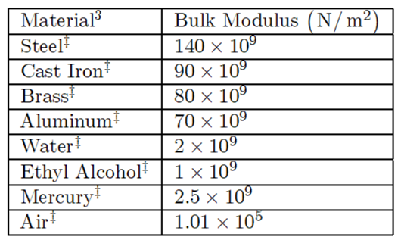

Slide 10


dx
Cross sectional area, A
dm
$$F_{pℓ}$$
$$F_{pr}$$

Slide 11
P
s(x+Δx)
s(x)
A
0
x
x+Δx

Slide 12
P
s(x)
0
x
s(x+Δx)
0
x
x+Δx
Δs

Slide 13
End

Slide 14
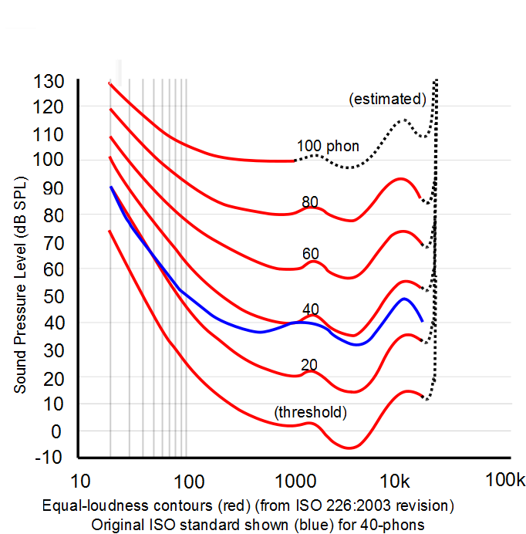
Frequency Response

Slide 16
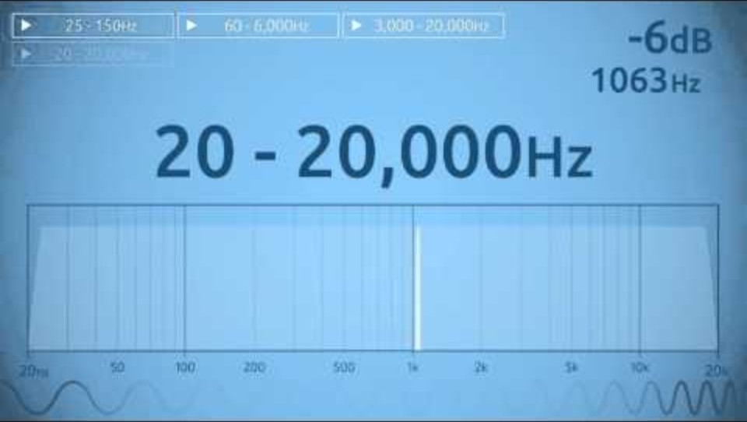

Slide 17
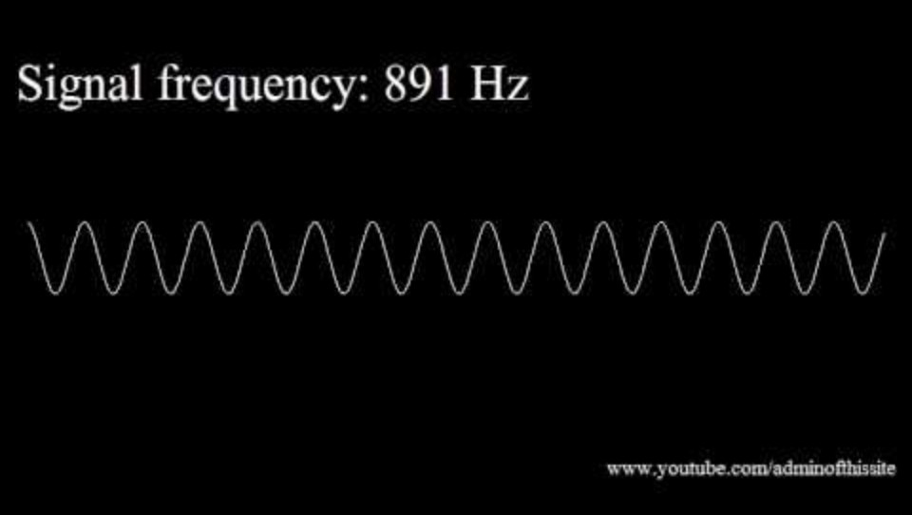

Slide 18
Question 223.4.11 123.22.7
Suppose I have a loud speaker and 1m away from that loud speaker I measure an intensity of 1W /m². What is the sound level?
a) 3dB
b) 10dB
c) 120dB
d) 150dB

Slide 19
Question 223.4.12 123.22.8
Suppose I have a loud speaker and 10m away from that loud speaker I measure an intensity of 0.01 W /m². What is the sound level?
a) 30dB
b) 100dB
c) 120dB
d) 150dB

Slide 20
Question 223.4.13 123.22.9
Suppose I have two French horn players both playing the same note at the same time. I stand a meter away and find that they are each playing with an intensity of 0.00001 W/m². What is the sound level?
a) 0.00001
b) 70dB
c) 73dB
d) 1400dB

Slide 21
Question 223.4.14 123.22.10
You are sitting in church. The speaker is talking into a microphone. The sound system radiates sound with a power of 50W . You are 20m from the sound system output. What is the sound level?
a) 78dB
b) 80dB
c) 100dB
d) 120dB

Slide 22
Question 223.4.15 GR 123.22.11 GR
You are standing outside a Guns & Roses Concert. The concert is in a stadium. You are 40 m from the stadium. You have a sound level meter with you and find that where you stand the sound level is 120dB. How much acoustic power are the “musicians” creating at their output location?
a) 78W
b) 134W
c) 545W
d) 20106W

Slide 23
Question 223.4.16 123.22.12
You are sitting in church. The speaker is talking into a microphone. The sound system radiates sound with a power of 100W . You are 10m from the sound system output. What is the sound level? We can find this using our new SIL equation that includes power and distance.
a)50dB
b) 78dB
c) 109dB
d) 140dB

Slide 24
Δx
v
A

Slide 25


Sound Wave In
Sound Wave Out
A
$ρ_{in},v_{in},T_{in}$
$ρ_{out},v_{out},T_{out}$
Parcel of Air

Slide 26
P
dz
P
P+dP
dy
dx

Slide 27
Question 223.6.1.6
A pulse is traveling on a rope. If one end of the rope is not tied to anything, a pulse will still reflect off of this “free end.” Will the reflected pulse be inverted?
Yes
No
Maybe
Can’t tell

Slide 28

Question 223.6.3 Question 123.23.2
A wave travels across a boundary between two different weight ropes. If it goes from the heavier to the lighter rope, the wave speed
  Increases
  Decreases
  Stays the same
  Can’t tell

Slide 29
Question 223.6.2
A wave travels across a boundary between two different weight ropes. If it goes from the lighter to the heavier rope, the reflected wave
Is inverted
Is not inverted
Can’t tell

Slide 30
Question 223.6.4 Question 123.23.1
Two identical waves travel in opposite directions in a medium. If each wave has amplitude, A, the maximum amplitude of the resultant wave would be
A
2A
4A
A/2

Slide 31
Question 223.6.5 Question 123.23.3
Does the node of a standing wave move in the x direction?
Yes
No
Neither

Slide 32
Question 223.6.6 Question 123.23.4
The nodes of a standing wave occur at
And the antinodes occur at
Wait… none of these is technically correct! (if you choose this answer, be ready to explain why)

Slide 33
Question 223.6.7 Question 123.23.5
I have my trusty ukulele and I have a string experiencing a standing wave. Which frequency corresponds to this wave shown?
The fundamental
The second harmonic
The third harmonic
The fourth harmonic

Slide 34
Question 223.6.8 Question 123.23.5
A string is clamped at both ends and plucked so it vibrates in a standing mode between two extreme positions a and b. Let upward motion correspond to positive velocities. The graph below is a collection of snapshot graphs (piled on top of each other). When the string is in position c, the instantaneous velocity of points along the string:
  a) is zero everywhere. c) is negative everywhere.
  b) is positive everywhere. d) depends on x-position.
y
a
c
x
b

Slide 35

Answer
D).
P
R
Q

Slide 36
Question 223.6.9 Question 123.23.6
A string is clamped at both ends and plucked so it vibrates in a standing mode between two extreme positions a and b. Let upward motion correspond to positive velocities. The graph below is a collection of snapshot graphs (piled on top of each other). When the string is in position b, the instantaneous velocity of points along the string:
  a) is zero everywhere. c) is negative everywhere.
  b) is positive everywhere. d) depends on x-position.
y
a
c
x
b

Slide 37

Answer
A)
R
Q
P

Slide 39
Question
A sound wave travels down a pipe. When it reaches the end what will happen?
The wave will keep going into the air in the room
The wave will stop at the end of the pipe and reflect back.
Some of the energy in the wave will keep going into the room air, and some will reflect back.
The pipe will explode

Slide 40
Question
A sound wave travels down a pipe. When it reaches the end of the pipe, Some of the energy in the wave will keep going into the room air, and some will reflect back. How does it reflect back?

Slide 42
Some reflect back
Some Keep Going

Slide 43
Question 223.7.1
A pipe, closed at one end, has a displacement node at one end. Why?
The pressure there must match atmospheric pressure
The molecules experience a 3rd law reaction force
The end prevents the molecules from moving in a longitudinal direction

Slide 44
Question 223.7.2
A pipe that is open at both ends has a standing sound wave generated in it. The pipe will have a pressure ____________ at both ends.
Node
Antinode
Neither

Slide 45
Question 223.7.2.5
A pipe, open on both ends has a tuning fork next to it which is oscillating at the pipe’s second harmonic frequency, How big is the wavelength compared to the pipe length?
λ = L/2
λ = L
λ = 2L
λ = (3/2)L

Slide 46
L
Displacement from Equilibrium
Pressure Change

Slide 47
L

Slide 48
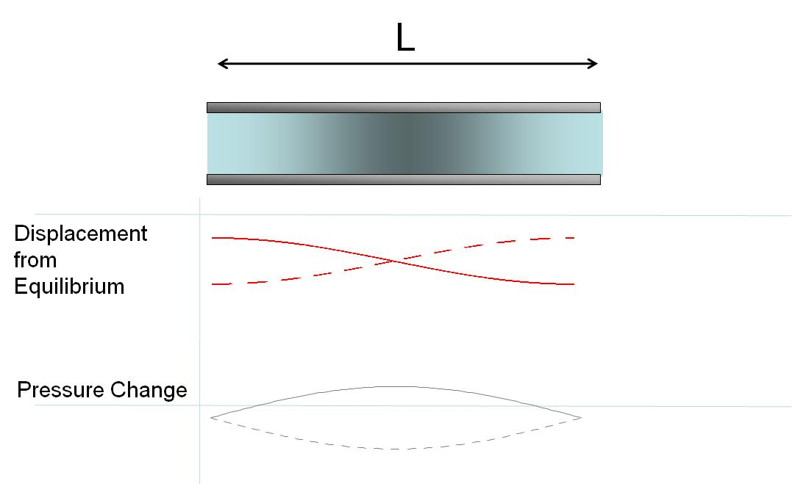
L
Displacement from Equilibrium
Pressure Change

Slide 49
L

Slide 50
Question 223.7.2.6
A pipe, open on both ends has a tuning fork next to it which is oscillating at the pipe’s second harmonic frequency. The pipe is 30cm long? The speed of sound is 343m/s. What is the frequency we will hear?
286Hz
572Hz
1143Hz
1715Hz
2287Hz

Slide 51
Question 223.7.2.7
A pipe, closed on one end has a tuning fork next to it which is oscillating at the pipe’s second harmonic frequency, How big is the wavelength compared to the pipe length?
286Hz
572Hz
1143Hz
1715Hz
2287Hz

Slide 52
Question 223.7.4
You have designed a support structure, but you find you have a device placed on the structure that excites a longitudinal natural frequency of a support strut. To dampen this effect you could
Clamp the strut at a non resonant point
Apply glue to the end where the struts fastens
Add a device that superposes another frequency on the strut
Can’t tell

Slide 53
Question 223.7.5
Suppose you have designed a large telescope with a whopping 6m diameter primary mirror. The telescope will be mounted on a motorized platform. Should you be concerned about vibration ruining your imagery?
No, the curved circular shape of the mirror precludes any longitudinal or transverse waves.
Yes there are normal modes of oscillation in any structure
No. the motor will produce longitudinal waves, such as a long thin structure like a rod can support.

Slide 54
Clamped Rod
The clamp prevents movement here
Atoms can move longitudinally here
Atoms can move longitudinally here

Slide 55
Clamped Rod: Center Clamp

Slide 56
Clamped Rod
The clamp prevents movement here
Atoms can move longitudinally here
Atoms can move longitudinally here

Slide 57
Clamped Rod: L/4 Clamp

Slide 58
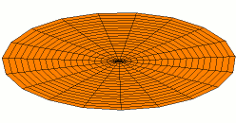
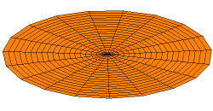
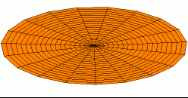
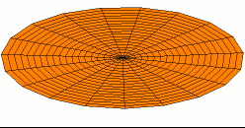
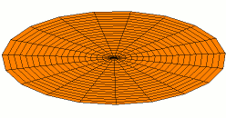
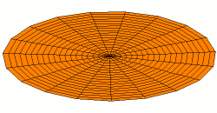
Drum Head

Slide 59
Question 223.7.3
Sound that produces standing wave frequencies that are not related by integer multiples is called
  Atonal
  Noise
  Circle of 5ths
  Guns n Roses
  Can’t tell

Slide 60
A flash from a light bulb gets the wave started
Reflected wave is inverted and forms a standing wave
Mirrors

Slide 61
Partial mirror that lets some light out
Amplifier
Mirrors

